Slide 1
Finding Solar Data
J. Ireland
Project Scientist for the Solar Data Analysis Center (SDAC) and SOHO

Slide 2
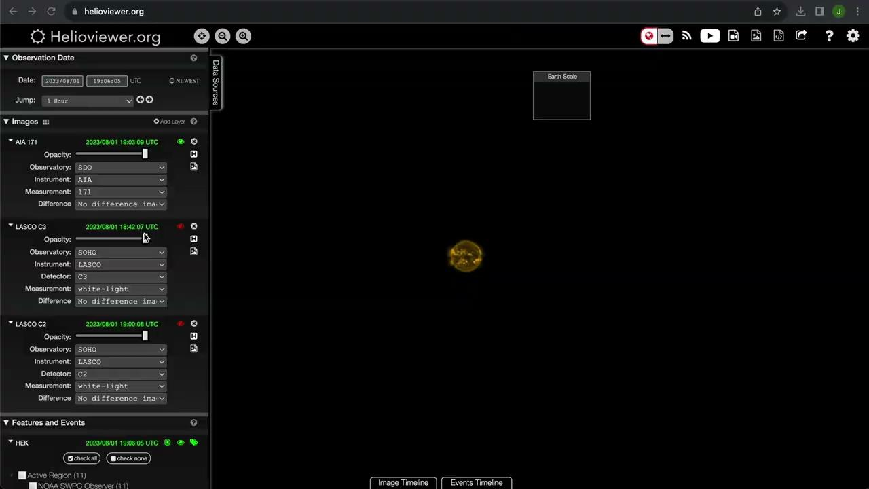
Browse - helioviewer.org

Slide 3
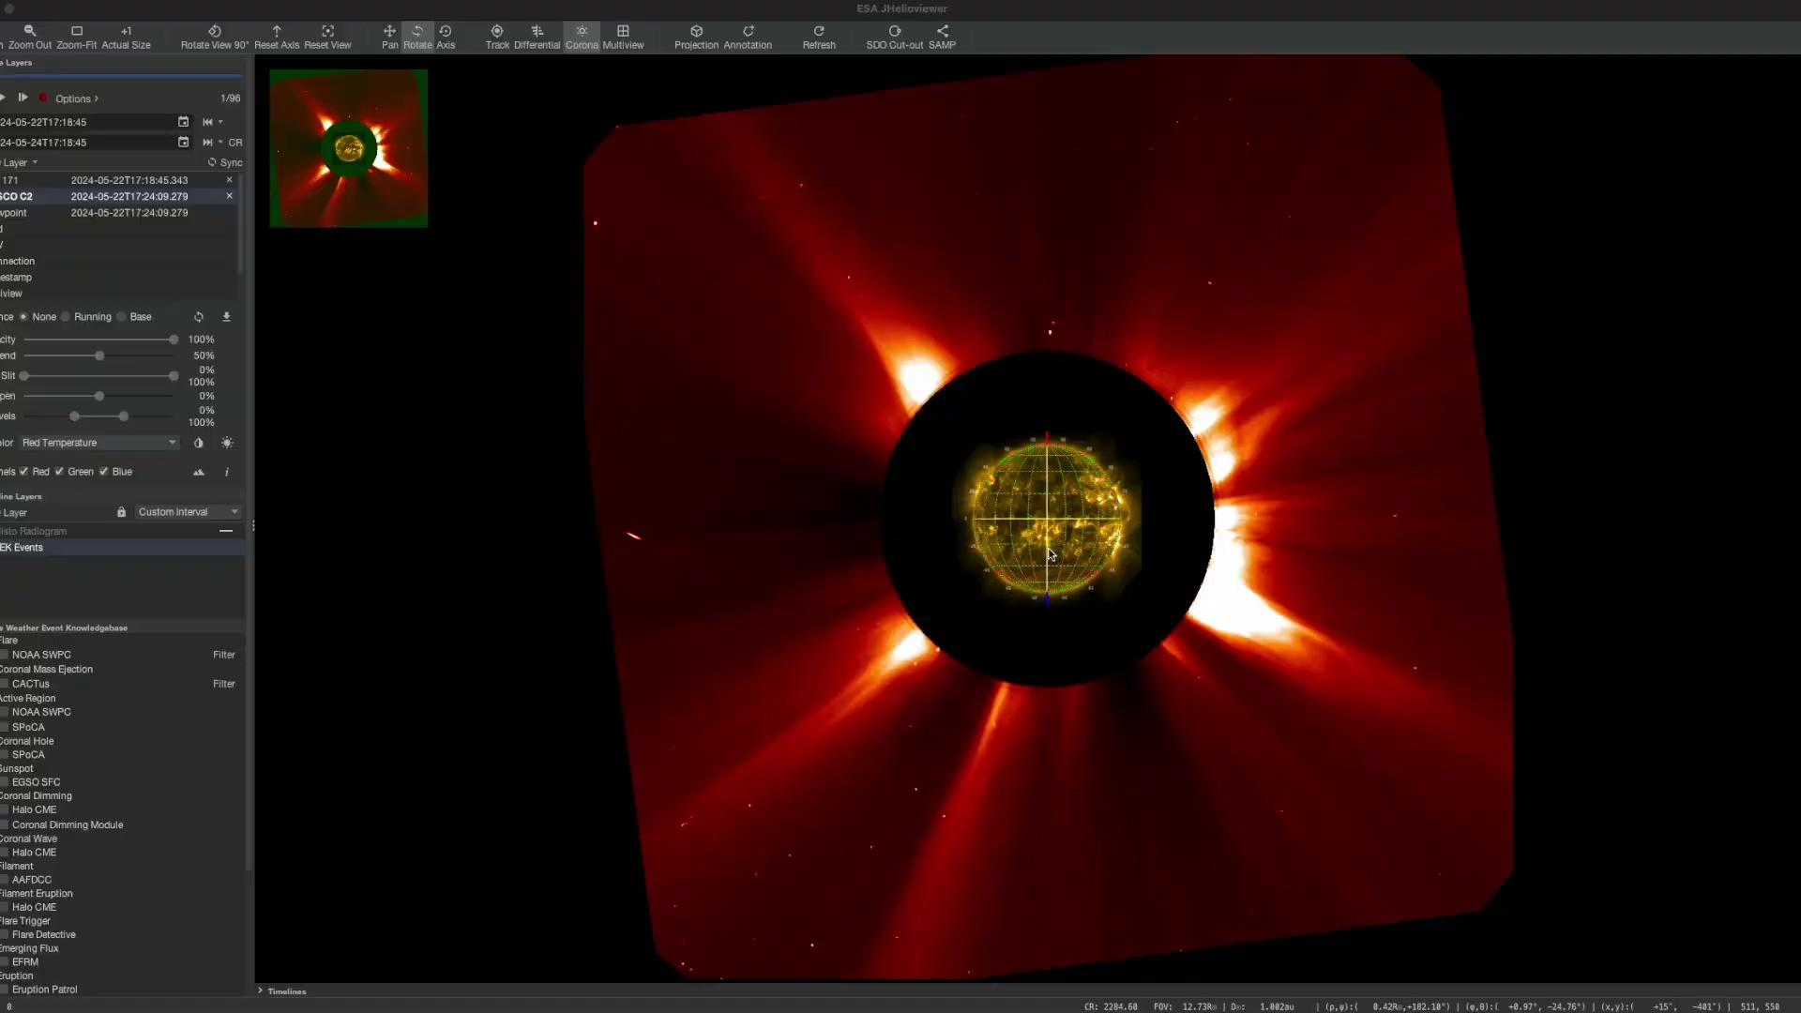
Browse - download from JHelioviewer.org

Slide 4
Install SunPy and use
Fido

Slide 5
Why?
Same interface for lots of different datasets
More efficient for the user
Lots of data searchable
All the data available via the Virtual Solar Observatory (VSO)
Heliophysics Event Knowledgebase (HEK)
CDAWeb
Powerful search capabilities
Logical AND / OR
Can search on feature and event properties
Extensive documentation and examples

Slide 6

SunPy / Fido
Queries to multiple data providers
VSO
results
query
results from multiple data providers
HEK
query
Fido
User
results
query
HELIO
results
query
Data source implemented in Fido

Slide 7
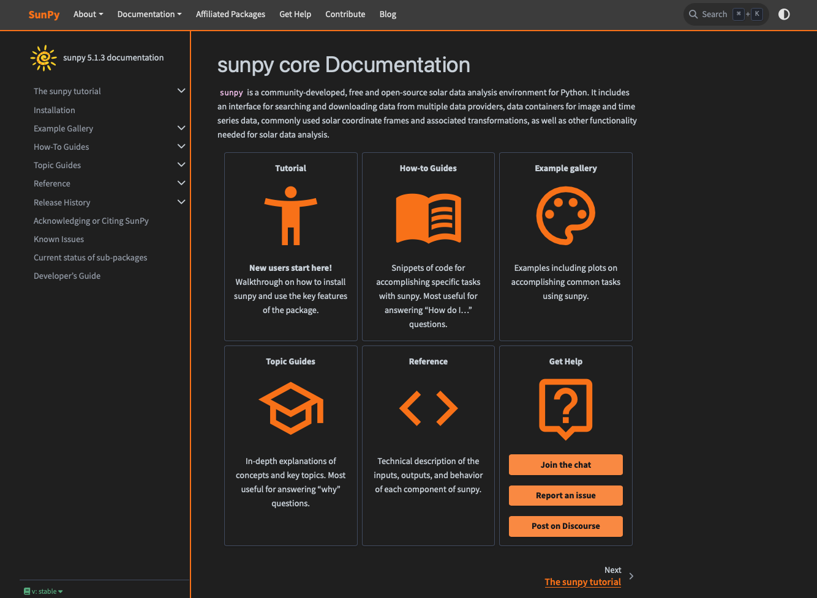
docs.sunpy.org

Slide 8
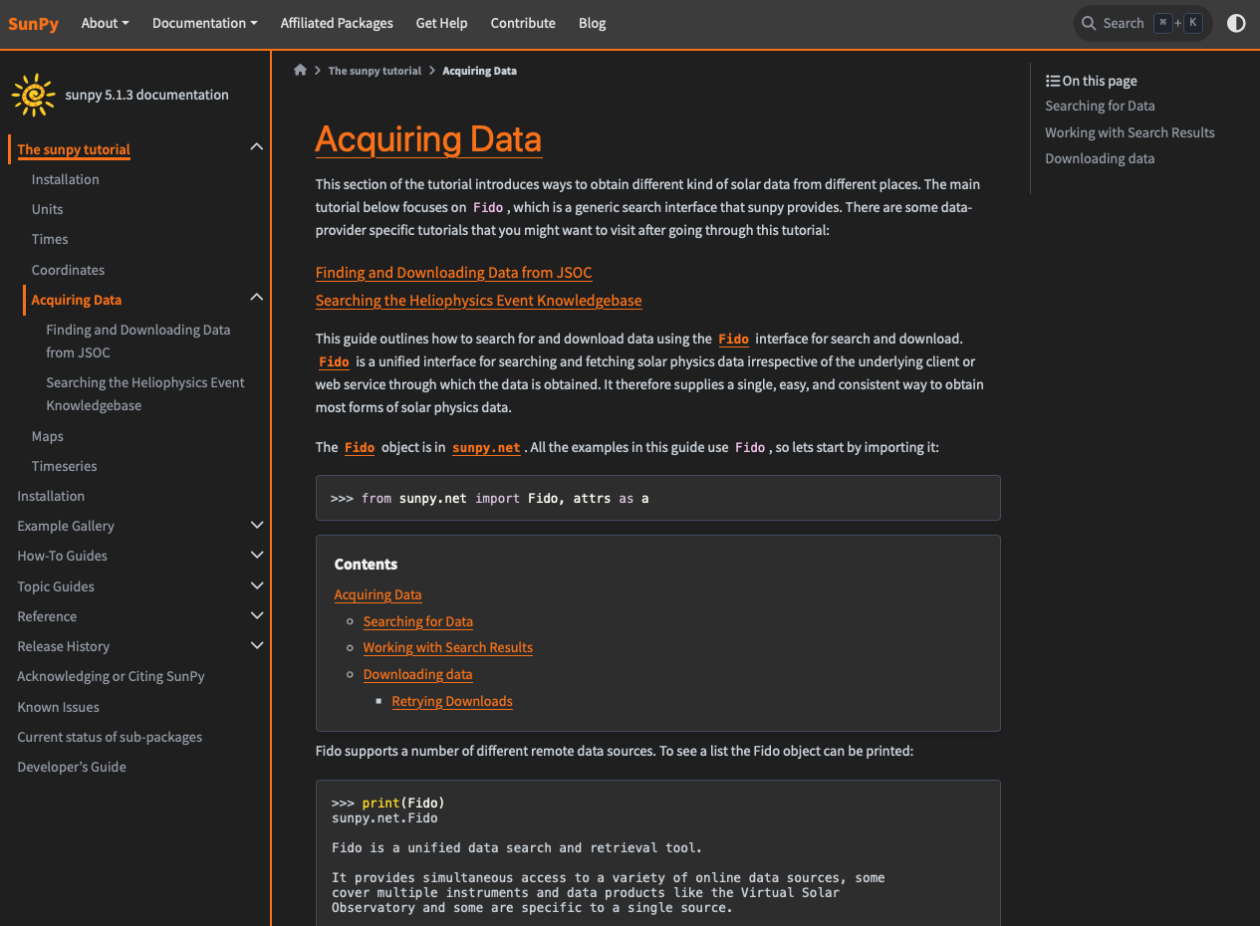

Slide 9
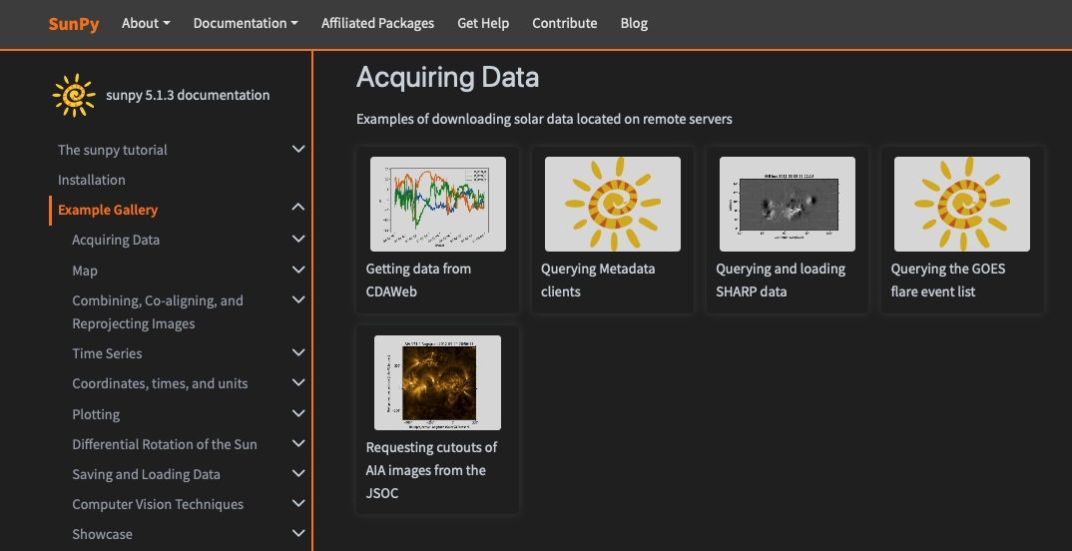

Slide 10
Install SunPy and use
Fido

Slide 11
End

